Slide 1


Smart Contract Development With Solidity
Inheritance and Multiple Contracts
SoftUni Team
Technical Trainers
Software University
http://softuni.bg

Slide 2
Table of Contents
Calling other contracts
Account type - send, call, delegatecall
Inheritance
constructors of parents
multiple inheritance
Abstract contracts
Interface contracts
Libraries
Directive “using x for y”

Slide 3
Questions
sli.do #SContracts

Slide 4
Аddress Тype Мembers
Very low level! Avoid if possible
send
Like transfer, but returns false instead of throwing exception on failure. Always check return value!
call – breaking change with version 0.5.0
only one argument
method id and arguments packed with abi.encodeWithSignature
returns tuple (bool, bytes)
delegatecall - breaking change with version 0.5.0
execute external code on internal state

Slide 5
Calling Other Contracts
Contracts can publish other contracts
Contracts can interact with published contracts
Can be done via multiple ways
A contract call to another contract is referred to a message call.
All calls are within the same TX and must fit the gas limit
A contract calling another can limit the amount of gas the other can use

Slide 6
Globally Available Variables
The members of msg (msg.sender, msg.value, …) are the ones from the last call, not the whole transaction!
If contract A calls B, in the code of B, msg.sender will be A
The initial caller of the transaction is tx.origin

Slide 7

Example
creating other contracts
calling other contracts via provided address
call vs delegatecall

Slide 8

Exercise 1

Slide 9
Inheritance
A contract can inherit the functions and variables of other contracts.
The deriving contract can access all non-private members of the parent contract just like it would access its own
If A inherits B, when publishing A, you can think of it as if the code of B is “copy-pasted” to A and the contract is published
Only one contract exists and only one is published
The compiler does not literally copy paste
The input parameters of constructors of parent contracts should be provided by the child contract.

Slide 10
Overriding
A function can be overridden by another function having the same name and same number/types of parameters.
contract A {
function test(uint256 number) public {}
}
Contract B is A {
function test(uint256 number) public {}
}

Slide 11

Example
basic inheritance code example
overriding inheritance code example
inheritance with constructors

Slide 12
Multiple Inheritance
A contract can inherit multiple contracts at once
Very similar to Python’s inheritance rules
“most base-like” to “most derived”
Diamond problem
A
B
C
D

Slide 13

Example
basic multiple inheritance
linearization explained

Slide 14
Multiple Inheritance
S2
S3
S1
S4
S6
S5

Slide 15
Exercise 2

Slide 16
Abstract Contracts
Abstract contracts are such that contain at least one not implemented function
They cannot be compiled and published
They can be used as base contracts
If the inheriting contract doesn’t implement all not implemented methods, it also becomes an abstract contract
They can be used to declare the interface of published contracts

Slide 17
Interface Contracts
Like abstracts, but with the additional limitations:
Cannot have implemented functions
Cannot inherit other contracts or interfaces
Cannot define constructor, variables and custom types (struct, enum, …)
They contain only information from the ABI definition

Slide 18
Libraries
Libraries are contracts
do not have storage
they cannot hold ether
cannot inherit or be inherited by other contracts
Libraries can be seen as implicit base contracts of the contracts that use them

Slide 19
Libraries
Their code is executed in the context of the calling contract
Not an external call!
You can pass storage references to libraries
Libraries is an external piece of code that interacts internally with our contract

Slide 20
Solidity’s ‘using’ Keyword
Used to bind library functions to a certain data type
Syntactic sugar
using SomeLibrary for uint;

Slide 21

Example
abstract contracts
interface contracts
libraries contracts
using x for y

Slide 22
Exercise 3

Slide 23
Interesting content
https://blog.aragon.one/library-driven-development-in-solidity-2bebcaf88736
https://blockgeeks.com/guides/ethereum-casper/
https://medium.com/cardstack/upgradable-contracts-in-solidity-d5af87f0f913

Slide 24
https://softuni.bg/trainings/courses

Slide 25













SoftUni Diamond Partners

Slide 26

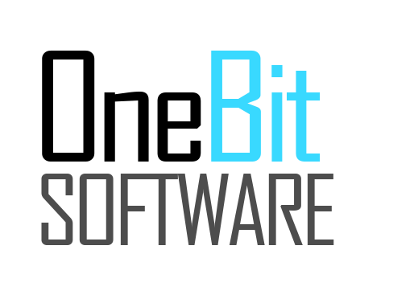



SoftUni Organizational Partners

Slide 27




Trainings @ Software University (SoftUni)
Software University – High-Quality Education and Employment Opportunities
softuni.bg
Software University Foundation
http://softuni.foundation/
Software University @ Facebook
facebook.com/SoftwareUniversity
Software University Forums
forum.softuni.bg

Slide 28

License
This course (slides, examples, demos, videos, homework, etc.) is licensed under the "Creative Commons Attribution-NonCommercial-ShareAlike 4.0 International" license

